Slide 1
home
portfolio
about me
contact
Hello guys
I prefer drawing to talking.
Drawing is faster and leaves less room for lies.
SEE MY WORK
CONTACT
Notes:
Bổ sung nút Theme

Slide 2

Contact me:
CONTACT INFO
Phone: 0346 189 173
Mail: nguyenmanhdung1996@gmail.com
ADDRESS
4 Thuy Khue street, Tay Ho district, Ha Noi city
CONTACT INFO
Facebook: NguyenManhDung1996
Instagram: dungbubu
Notes:
Bổ sung nút Theme

Slide 3
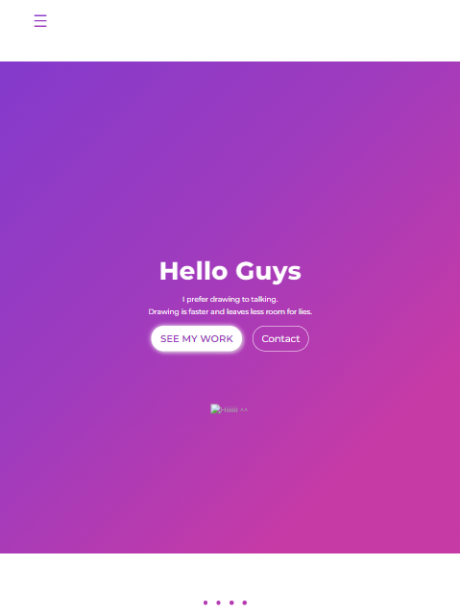
Montserrat Medium
IPAD
#f6f6f6
#843ACC
#9E3BBE
#C63AA6

